Slide 1
EMPLOYEE DATA ANALYSIS USING EXCEL
STUDENT NAME: BHUVANESHWARI.T
REGISTER NO : 422200470
NAAN MUDHALVAN ID:AD2C5F4E0A2325B8531496BAD376C5B6
DEPARTMENT : B.COM(ISM)
COLLEGE NAME: VALLIAMMAL COLLEGE FOR WOMEN

Slide 2
PROJECT TITLE
Employee Performance Analysis Using Excel

Slide 3
AGENDA
Problem Statement
Project Overview
End Users
Our Solution and Proposition
Dataset Description
Modelling Approach
Result and Discussion
Conclusion

Slide 4
Problem statement
This Performance analysis is used to find out the employee performance level growing or not

Slide 5
Project overview
Analyse the performance level of the employee by considering various factors of like empID,business unit,gender,current empolyee rating,employee type etc,.We use these in order to identify the trends.In this chart different categories of employee performance level like very high,high,med,low.

Slide 6
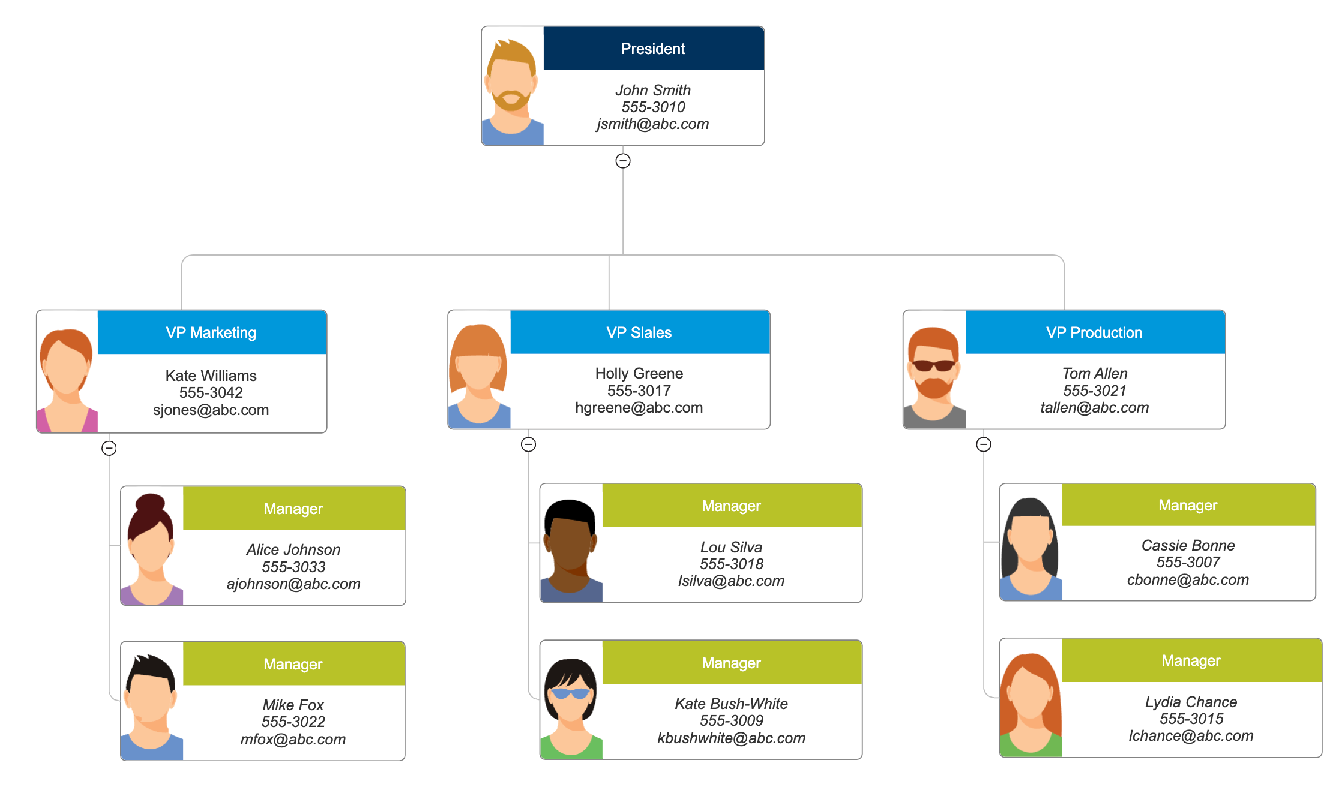
Who are the end users ?

Slide 7
Our solution and its value proposition
Conditional formating- Blank values.
Sort and Filter-Filter-Remove Blank values.
Formula-current empolyee rating performance level.
Pivot Table-Summary.
Chart or Graph-Data Visualization

Slide 8
Dataset description
Empolyee Dataset-Edunet Dashbord.
27 Features.
11Features.
Employee ID-Numerical values.
Name-Text.
Gender-Text.
Performance level-numerical values.
Start Date- Numerical Values.

Slide 9
The "wow" in our solution
We using this formula=IFS(Z8>=5,”VERYHIGH”,Z8>=4,”HIGH”,Z8>=3,”MED”,TRUE,”LOW”)
To find the performance level of the empolyee.

Slide 10
modelling
DATA COLLECTION:
Naan Mudhalvan
Edunet Dashboard.
FEATURE SELECTION:
27Features.
11Features.
DATA CLEANING:
Colour blank values
Fliter-Remove Blank values
PERFORMANCE LEVEL:
Very High
High
Medium
Low
PIVOT TABLE:
Empolyee ID
Name Gender
Current rating performance
Performance Level
Start date
Employee Type

Slide 11
results

Slide 12
conclusion
While comparing the performance level of the employee. The empolyee’s are getting their employee performance level according to their empolyee type and start date.

